Slide 1


The Presentation Will Begin Shortly!
© 2021 Premera. Proprietary and Confidential.

Slide 2
Premera Small Group Product Update
2022
© 2021 Premera. Proprietary and Confidential.

Slide 3
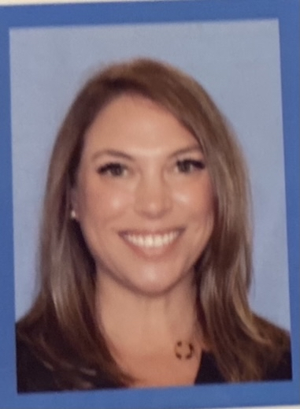





Team Introductions
Ben Helsel
Washington
benjamin.helsel@premera.com
Cell: 206-915-0559
Amy Easley
Western Washington
amy.easley@premera.com
Cell: 206-369-6330
Andy Lentz
Western Washington
andy.lentz@premera.com
Cell: 206-499-7883
Curt Esteb
Eastern Washington
curt.esteb@premera.com
Cell: 425-590-7118
Rachel Miller
Eastern Washington
rachel.miller@premera.com
Cell: 509-368-1912
© 2020 Premera. Proprietary and Confidential.
3
© 2019 Premera. Proprietary and Confidential.
© 2020 Premera. Proprietary and Confidential.
3

Slide 4
Agenda
 | Market Changes
 | Medical Plans
 | Other Programs and Services
 | Peak Care
 | Vivacity Care Center
 | Dental Plans
 | Sprint Bonus
© 2021 Premera. Proprietary and Confidential.

Slide 5

Market Overview and Changes
© 2021 Premera. Proprietary and Confidential.

Slide 6
2022 Rate Position
Product and rates presented pending OIC approval
Overall premium rate increase – Pending 4%
© 2021 Premera. Proprietary and Confidential.
6

Slide 7

Medical Plans
© 2021 Premera. Proprietary and Confidential.

Slide 8
2022 Medical Portfolio Families
 | Balance plans*
Heritage Signature network | Balance 250 Platinum
 | Balance 500 Platinum
 | Balance 500 Gold
 | Balance 1000 Gold
 | Balance 1500 Gold
 | Balance 2000 Gold
 | Balance 2500 Gold
 | Balance 2000 Silver
 | Balance 3000 Silver
 | Balance 6500 Bronze
 | Balance EPO 8550 Bronze
 | Peak Care plans
Tahoma network | Peak Care 1000 Gold EPO
 | Peak Care 2500 Gold EPO
 | Peak Care 3000 Gold EPO
 | Peak Care NOW 4000 Silver
 | Peak Care 6000 Bronze EPO
 | HSA-Qualified plans
Heritage Signature network | Balance HSA Qualified 1500 Gold
 | Balance HSA Qualified 3000 Silver
 | Balance HSA Qualified 3000 Silver + Family Dental
 | Balance HSA Qualified 6200 Bronze
Heritage network | Choice HSA Qualified 1500 Gold
 | Choice HSA Qualified 3000 Silver
 | Choice HSA Qualified 3000 Silver + Family Dental
 | Choice HSA Qualified 6200 Bronze
 | Medical + Family Dental plans
Heritage Signature network | Balance 500 Gold + Family Dental
 | Balance 1000 Gold + Family Dental
 | Balance 2000 Silver + Family Dental
 | Balance HSA Qualified 3000 Silver + Family Dental
Heritage network | Choice 750 Gold + Family Dental
 | Choice 1000 Gold + Family Dental
 | Choice 2500 Silver + Family Dental
 | Choice HSA Qualified 3000 Silver + Family Dental
New!
 | Choice plans
Heritage network | Choice 750 Gold
 | Choice 1000 Gold
 | Choice 1500 Gold
 | Choice 2500 Silver
*Not shown: Balance 1000 Basic Gold
© 2021 Premera. Proprietary and Confidential.
8

Slide 9




Summary of Changes for Medical
Non-Qualified Plans
2021 Benefits
2022 Benefits
Platinum
No Medical or Rx Changes
No Medical or Rx Changes
Gold
Out-of-Pocket Maximum
Balance/Choice 1000 - $8,100
Balance/Choice 1500 - $6,500
Peak Care 1000 - $8,200
Urgent Care
Peak Care 1000 - PCP cost share
Out-of-Pocket Maximum
Balance/Choice 1000 - $8,200
Balance/Choice 1500 - $6,600
Peak Care 1000 - $8,300
Urgent Care
Peak Care 1000 - Specialist cost share
Silver
No Medical or Rx Changes
No Medical or Rx Changes
Bronze
Urgent Care
Peak Care 6000 - PCP cost share
Urgent Care
Peak Care 6000 – Specialist cost share
© 2021 Premera. Proprietary and Confidential.
9

Slide 10
Summary of Changes for Prescription Drugs
Qualified HDHPs Plans
2021 Benefits
2022 Benefits
Gold HSA
Preventive Drug List – PV1
Preventive Drug List – PV Core
Silver HSA
Preventive Drug List – PV1
Preventive Drug List – PV Core
Bronze HSA
Preventive Drug List – PV1
Preventive Drug List – PV Core
© 2021 Premera. Proprietary and Confidential.
10

Slide 11
Summary of Changes for Prescription Drugs
Qualified HDHP
Formulary M1
Rationale
Benefits
IRS released updated guidance on what is considered “preventive”
Limited and lean PV offerings compared to competitors
Too many low value drugs on current PV lists & missing certain high value drugs (e.g. insulins)
Ensures IRS compliance
Creates a more flexible, robust offering
Ensures coverage of high value drugs only
© 2021 Premera. Proprietary and Confidential.
11

Slide 12

Peak Care NOW – New for 2022
Peak Care NOW 4000 Silver
Deductible
$4000
Peak Care NOW 4000 Silver
Coinsurance
20%
Out of Pocket Maximum
$8,550
Office Visit Copay
Designated PCP - $0
Specialist/Non-designated - $50
Virtual Care (App based)
$0
Basic Diagnostic Lab & X-ray
Deductible/Coinsurance
Rehabilitation
Unlimited
Deductible/Coinsurance
Urgent Care
$0
Emergency Room
$450 copay, then Deductible/Coinsurance
Pharmacy
$20/%50/Ded, then 50%/Ded, then 30%
© 2021 Premera. Proprietary and Confidential.
12

Slide 13
Virtual Care
Subject to OIC approval
 | Providers | Benefit Category | Cost Share
Primary/Urgent Care and Mental Health | 98point6 Doctor on Demand | Telemedicine General Medical Virtual care only | $5 Copay (non-QHDHP); Deductible/Coinsurance
Mental Health | TalkSpace Doctor on Demand | Telemedicine Mental Health Virtual Care Only | Mental Health office visit cost share
Substance Use Disorder | Boulder Care | Telemedicine Chemical Dependency Virtual care only | Chemical Dependency office visit cost share
 | Workit
Brick and Mortar (traditional provider) Telemedicine embedded in all plans following professional OV cost shares.
© 2021 Premera. Proprietary and Confidential.
13

Slide 14
Wellness Program – Discontinued for 2022
Reasons for discontinuing the Wellness program include:
    Low utilization – average less than 1.5% of enrollment
    Removal of this program resulted in significant cost savings to the SG plans
© 2019 Premera. Proprietary and Confidential.
© 2021 Premera. Proprietary and Confidential.
14

Slide 15
2022 Multiple Choice Guidelines
Groups with 8-50 enrolled employees may offer dual choice by combining two Premera Medical plans
Groups with 15-50 enrolled employees may offer triple choice by combining three different Premera Medical plans
A minimum of one person must enroll on each plan and the employer must offer the multiple choice programs to all employees
Plan combinations cannot span across multiple networks except for allowable combinations with a Peak Care plan
All plans must be the same or one adjacent metallic level with each other.
  Examples: Two gold plans; one gold plan with one silver plan; one silver plan with one bronze plan, etc.
  When combining Peak Care plans with one of a different network, the Peak Care plan must match the highest metal level of the other plan(s)
  Plan combinations cannot include platinum level plans and/or EPO plans (excluding Peak Care)
Groups may not mix Medical Only plans with plans that offer embedded Dental benefits (+ Family Dental plans)
© 2021 Premera. Proprietary and Confidential.
15

Slide 16

Other Programs and Services
Additional programs and services to enhance the member experience.
© 2021 Premera. Proprietary and Confidential.

Slide 17
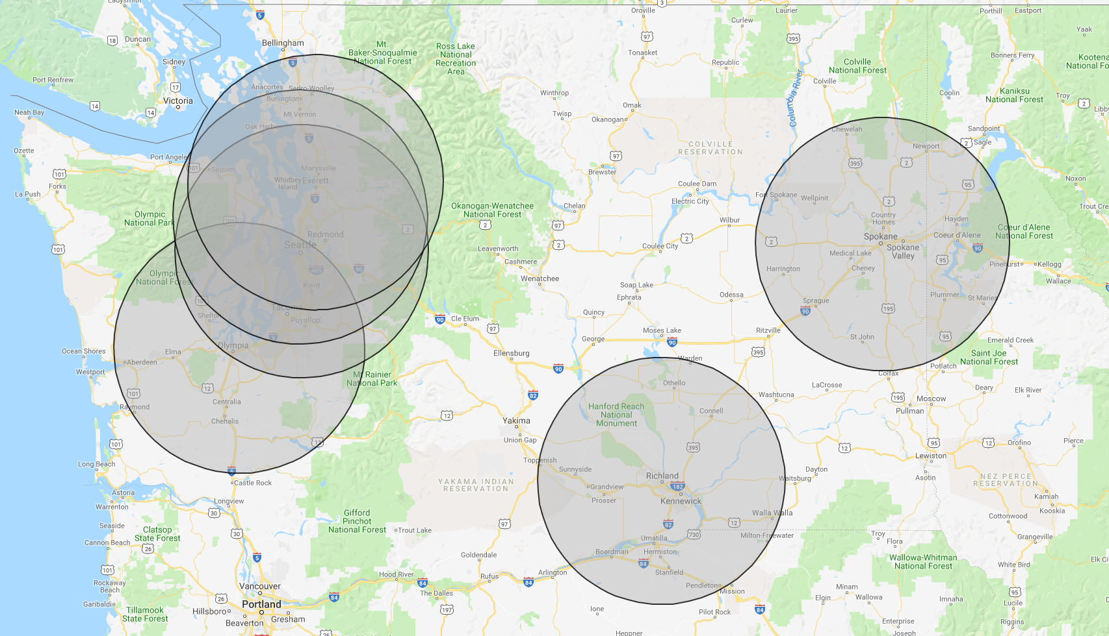

Premera Designated Centers of Excellence
Local Approach: Integrated purchasing strategy + BDSC
The first local Premera Designated Center of Excellence is Providence St. Joseph Health (7 locations) for total joint replacement surgeries
Unique provider partnerships for total joint replacement
Enhance Premera's overall COE program as the primary Centers of Excellence in our local market
Establish bundled payment arrangements for total joint replacement
Certify they meet certain clinical guidelines, such as adhering to Bree Collaborative guidelines, to ensure the best clinical outcomes
Facilitate Blue Distinction Specialty Care designations so they align under the broader COE program/strategy
© 2019 Premera. Proprietary and Confidential.
© 2021 Premera. Proprietary and Confidential.
17

Slide 18
Premera Designated Centers of Excellence
Medical Benefit Differentials
Medical Services
Cost shares waived for eligible medical services at designated COE providers
PPO Plans: Waive deductible & coinsurance
QHDHP Plans: Deductible, then coinsurance waived
Travel Expenses
Cost shares waived for eligible medical travel expenses related to accessing care at designated COE providers
PPO Plans: Waive deductible & coinsurance
QHDHP Plans: Deductible, then coinsurance waived
Benefit differentials apply to:
Pre-operative visit and related care
Surgery and inpatient stay, including facility, profession charges and related services
Post-operative visit and related care
Covered travel expenses include airfare, lodging and ground transportation up to IRS guidelines
© 2019 Premera. Proprietary and Confidential.
© 2021 Premera. Proprietary and Confidential.
18

Slide 19
Premera Designated Centers of Excellence
Small Group Benefit Design
© 2019 Premera. Proprietary and Confidential.
19
© 2021 Premera. Proprietary and Confidential.

Slide 20





Behavioral Health Navigation - Quartet
Reach people who need care
Connect people to the right care
Track the quality of people’s care
Support member’s care journeys
Through Quartet, members can be referred to mental health care by a provider, Premera Personal Health Support, or sign up directly. Their platform can also proactively screen for people who may need care using claims data to fuel their predictive analytics.
Quartet helps match people to the best mental health care for them based on their preferences, clinical needs, and insurance. These care options include therapy, psychiatry, or digital online programs, and can be in-person or virtual.
We need to measure mental health as robustly as physical health. Quartet tracks people’s progress to ensure they’re getting healthier over the course of their sessions.
HIPAA-compliant platform fosters collaboration between a person's mental health provider and referring provider. When someone needs extra support on their care journey, they can also talk to a dedicated Quartet Care Navigator.
© 2021 Premera. Proprietary and Confidential.
20

Slide 21
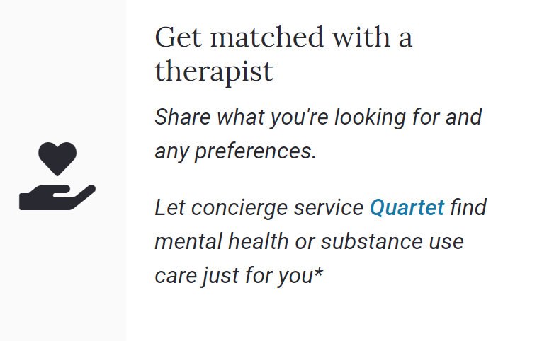
Behavioral Health Navigation - Quartet
For more information on Quartet visit https://www.premera.com/visitor/care-essentials/mental-health
.
© 2021 Premera. Proprietary and Confidential.
21

Slide 22

Explore My Benefits
What is Explore My Benefits?
Explore My Benefits is an experience to ease member pain points around understanding their benefits and plan. Members see current information as overwhelming so we are looking to create a simple, more intuitive experience with benefit information, where the customer can explore first, before having to login. We are bringing benefit or plan information (simplified topics and frank tone) to the member based on how we see small group members use their plans. The website will address initial information needs around members that use their plan for check-ups and staying healthy, those that are planning a surgery or other major event and finally members who manage a chronic health condition like diabetes. Each topic will include care options and/or “important things to know.”
Why is it needed?
Premera is looking for ways to better serve our members. We want to build bridges to connect members to what they need and want, all with the goal of making healthcare work better.
Who is it for?
We are testing a new experience for WA Small Group members with 7/1/21 plan effective dates and then again 1/1/22.
When will members get access?
Members will be invited by email to explore their benefits by connecting wit explorepremera.com.
What’s next?
What we learn from these members will be incorporated into the site with the goal of having an experience that helps all Washington Small Group members better understand and maximize their benefits.
© 2019 Premera. Proprietary and Confidential.
© 2021 Premera. Proprietary and Confidential.
22

Slide 23

The Customer is at the Center of What We Do
Strategize and design with the member in mind
Continued adoption of a customer-centric culture
Amplify member voices
Build credibility, trust, and transparency with members
© 2019 Premera. Proprietary and Confidential.
© 2021 Premera. Proprietary and Confidential.
23

Slide 24
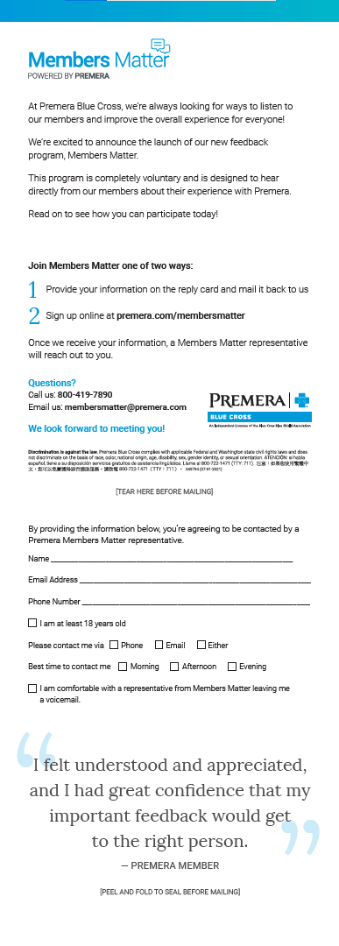
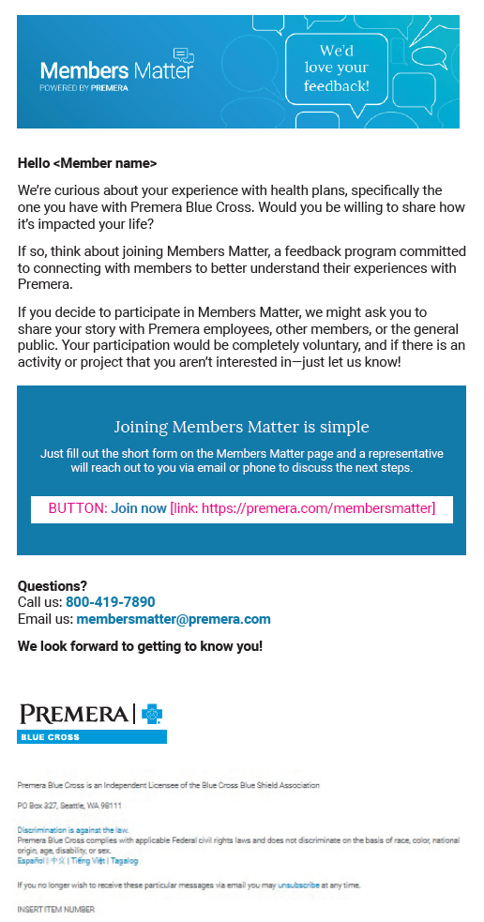

Recruitment and Engagement
One Offs
Consult with member to get and incorporate feedback through a one-way communication model
Involve member to ensure their needs and interests are considered for specific projects or programs
Programmatic
Ongoing
Collaborate with member through two-way ongoing communication and partnership building
© 2019 Premera. Proprietary and Confidential.
© 2021 Premera. Proprietary and Confidential.
24

Slide 25

Peak Care
Control spend while offering a quality health plan
© 2021 Premera. Proprietary and Confidential.

Slide 26

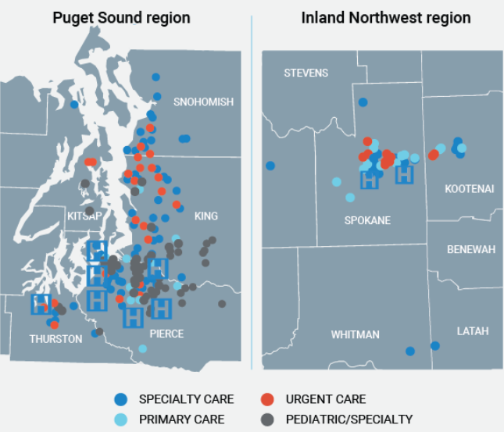
Premera-Designated Centers of Excellence
Peak Care
Integration drives value An innovative partnership between health plan and provider that brings a cost effective, quality health plan solution to local employers
Available in Pierce, Thurston, and Spokane counties Over 4,200 providers + robust virtual care options Leverages MultiCare’s clinically integrated network Dual-option strategy that gives employees choice to pick the best plan for their needs Peak Care members can access care while traveling out of state or worldwide with the BlueCard® Program. New for 2022: Peak NOW brings new plan options that give members cost-share free access to virtual care and PCPs
Up to 15% premium savings compared to traditional PPO plan

Slide 27
Premera-Designated Centers of Excellence
Peak Care
How Peak Care benefits businesses
Peak Care employee experience
Predictable yearly costs: priced for challenging economic times, it’s a plan option that will work to provide year-over-year budget stability.
Employee choice: implementing a dual-option benefits strategy that includes a Peak Care plan gives a workforce the power to choose the best plan for their needs.
Happy, healthy employees: offering a robust and cost-effective health plan supports employee job satisfaction and helps keeps them healthy.
Comprehensive network: over 4,200 providers
Virtual care access points: primary and urgent care, mental health care, substance use disorder, chemical dependency, and maternity care.
Health support: state-of-the-art digital tools and clinical programs to meet unique employee health needs
Plan perks: VIP customer service line, free rides to and from care, medical care team that comes to employee’s home, and complimentary employee valet parking at MultiCare clinics.
Nationwide coverage: access to care out of state with the BlueCard® Program.
“Peak Care is critical to your bottom line and your employees are well taken care of. It’s affordable, yet rich in benefits.” – Peak Care Employer

Slide 28

Vivacity Care Center
Premera’s Spokane Primary Care Solution
© 2021 Premera. Proprietary and Confidential.

Slide 29





Vivacity Care Centers
With Vivacity Care Centers, members get:
Flexible scheduling: Members can access care when they need it with same- or next-day appointments and virtual care options.
One-stop shop: VCC provides a single stop for a variety of primary care services such as labs, health coaching, X-rays, and behavioral health counseling.
Personal guidance: On-site Care Advocates are available to answer questions about health plan coverage and help patients navigate through the healthcare system..
Member focus: VCC patients experience care that is specific to them, with longer appointment times, thoughtfully designed spaces, and additional on-site services provided by a dedicated staff.
29
© 2019 Premera. Proprietary and Confidential.
© 2021 Premera. Proprietary and Confidential.
29

Slide 30
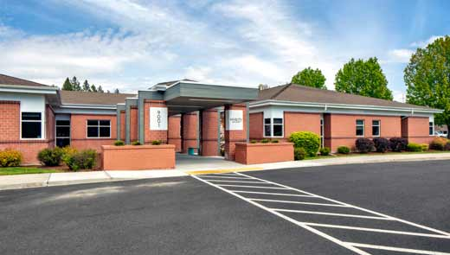
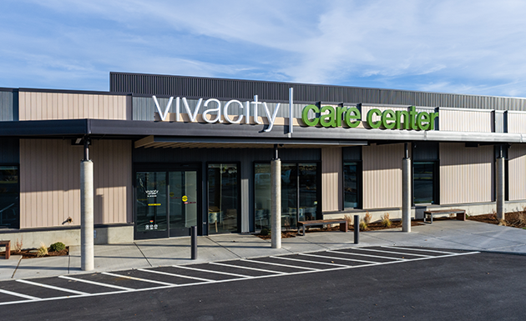
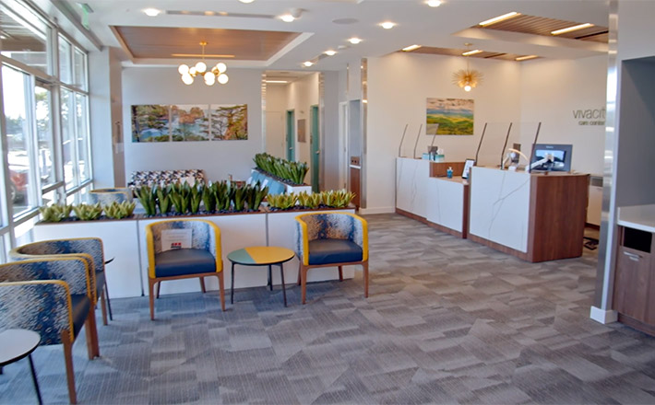

Now Serving 4 Locations in Spokane!
Hours of operation:
Monday – Friday
8 a.m. to 5 p.m.
9001 N Country Homes Blvd
Spokane WA 99208
16009 E Indiana Avenue
Spokane Valley WA 99216
1601 N Division Street
Suites A, B, C
Spokane WA 99207
307 W 6th Avenue
Spokane WA 99204
Services at this location include:
Services at this location include:
Services at this location include:
Services at this location include:
Primary care
Health coaching
Behavioral health
Laboratory services
Basic x-ray services
Insurance guidance
Primary care
Health coaching
Behavioral health
Laboratory services
Basic x-ray services
Insurance guidance
Primary care
Health coaching
Behavioral health
Laboratory services
Insurance guidance
Primary care
Health coaching
Behavioral health
Laboratory services
Insurance guidance
30
© 2019 Premera. Proprietary and Confidential.
© 2021 Premera. Proprietary and Confidential.
30
Notes:
Laboratory
Basic x-ray
Insurance Guidance

Slide 31

Current Model Design
Clinical & Business Model Structure
Currently only
for Premera and Lifewise members
• Commercial (FI & ASO)
• Individual/Small Group
• Medicare Advantage (MA)
Blue Card and
Federal Employee
Program (FEP) members
Newborns, pediatrics, adults, and MA
31
© 2019 Premera. Proprietary and Confidential.
© 2021 Premera. Proprietary and Confidential.
31

Slide 32

Dental Plans
© 2021 Premera. Proprietary and Confidential.

Slide 33
2022 Summary of Changes for Dental
Dental | 2021 Benefits | 2022 Benefit Changes
TMJ Rider | Duplicate portfolio with and without TMJ Rider | TMJ Rider will be embedded in all dental plans
Administration (Placement of inlay, onlay, crowns, or labial veneers) Effective 1/1/2022 Turnkey for all Premera Dental plans | Preparation Date | Seat Date
Contract Language | Non-uniform member contract language | Updating to uniform member contract language between lines of business
Pediatric Dental | No Changes | No Changes
© 2019 Premera. Proprietary and Confidential.
© 2021 Premera. Proprietary and Confidential.
33

Slide 34
Adult Dental Optima Plans
No changes for 2022 to PBC WA SG Adult Dental Optima Plans
All plans utilize the Dental Choice Network (broadest access)
Members can visit any dentist
Adult Dental Optima | $1000 | $1500 | $2000 | Voluntary $1000 |  | $1000 Enhanced | $1500 Enhanced | $2000 Enhanced | $1500 Enhanced+
Annual Deductible (applies to Class II & III) | $50/$150 | $50/$150 | $50/$150 | $50/$150 |  | $50/$150 | $50/$150 | $50/$150 | $50/$150
Coinsurance
Class 1 – Preventive | Covered in Full | Covered in Full | Covered in Full | Covered in Full |  | Covered in Full | Covered in Full | Covered in Full | Covered in Full
Class 2 – Basic | 20% | 20% | 20% | 30% |  | 20% | 20% | 20% | 20%
Class 3 – Major | 50% | 50% | 50% | 50% |  | 50% | 50% | 50% | 50%
Annual Maximum | $1,000 All Classes | $1,500 All Classes | $2,000 All Classes | $1,000 All Classes |  | $1,000 All Classes | $1,500 All Classes | $2,000 All Classes | $1,500 Class II & III Only *annual maximum waived for Class I
OON Reimbursement | WA out of network reduced fee schedule |  |  |  |  | FairHealth 90th Percentile
Endo/Perio Services | Classified as a Basic Service (20%) |  |  |  | Major (50%) | Classified as a Basic Service (20%)
Optional Orthodontia (26+ enrolled) | 50% with $1,500 Lifetime Max |  |  |  | N/A | 50% with $1,500 Lifetime Max
© 2019 Premera. Proprietary and Confidential.
© 2021 Premera. Proprietary and Confidential.
34

Slide 35
Adult Optima Group Size Requirements
Plan | OON | Groups Size 2-4 | Group Size 5+
Adult Dental Optima 1000 | WA out of network reduced fee schedule | X | X
Adult Dental Optima 1500 | WA out of network reduced fee schedule | X | X
Adult Dental Optima 2000 | WA out of network reduced fee schedule |  | X
Adult Dental Optima 1000 Enhanced | FairHealth 90th Percentile |  | X
Adult Dental Optima 1500 Enhanced | FairHealth 90th Percentile |  | X
Adult Dental Optima 2000 Enhanced | FairHealth 90th Percentile |  | X
Adult Dental Optima 1500 Enhanced+ | FairHealth 90th Percentile |  | X
Adult Dental Optima Voluntary 1000 | WA out of network reduced fee schedule |  | X
© 2019 Premera. Proprietary and Confidential.
© 2021 Premera. Proprietary and Confidential.
35

Slide 36

One Platform Ancillary Sprint Bonus
© 2021 Premera. Proprietary and Confidential.

Slide 37

One Platform Ancillary Sprint Bonus
Earn unlimited bonuses on new ancillary sales between 10.1.21 and 1.1.22!
For any new ancillary business sold to groups of 2-150 employees wit 10.1.21 through 1.1.22 effective dates:*
2 - 9 EEs, $75 per line
10 – 50 EEs, $100 per line
51 – 150 EEs, $125 per line
* No Minimum requirement
* No Maximum payout
© 2019 Premera. Proprietary and Confidential.
© 2021 Premera. Proprietary and Confidential.
37

Slide 38
Q&A: Please Type Questions Into the Chat
Ben Helsel
Washington
benjamin.helsel@premera.com
Cell: 206-915-0559
Amy Easley
Western Washington
amy.easley@premera.com
Cell: 206-369-6330
Andy Lentz
Western Washington
andy.lentz@premera.com
Cell: 206-499-7883
Curt Esteb
Eastern Washington
curt.esteb@premera.com
Cell: 425-590-7118
Rachel Miller
Eastern Washington
rachel.miller@premera.com
Cell: 509-368-1912
© 2020 Premera. Proprietary and Confidential.
38
© 2019 Premera. Proprietary and Confidential.
© 2020 Premera. Proprietary and Confidential.
38

